Slide 1
Exam Practice
Calculator Free:
2 questions
1st – 6 min
2nd – 7 min
Calculator Assumed:
2 questions
1st – 6 min
2nd – 6 min
Unit 2 – Lesson 1

Slide 2

Calculator Free Q1
Question 1 (6 marks) – 6 min
If $a=10$, $t=2$ and $u=5.5$, determine the value of $s$, where $s=ut+\frac{1}{2}at^{2}$. (2 marks)
(b) If $m=\frac{a+b+c}{3}$, determine the value of $a$ when $b=10$, $c=13$ and $m=9$. (2 marks)
(c) If $d=\sqrt{b^{2}−4ac}$, determine the value of $a$ when $b=3$, $c=−1$ and $d=5$. (2 marks)

Slide 3




Question 1 (6 marks) – 6 min
If $a=10$, $t=2$ and $u=5.5$, determine the value of $s$, where $s=ut+\frac{1}{2}at^{2}$. (2 marks)
(b) If $m=\frac{a+b+c}{3}$, determine the value of $a$ when $b=10$, $c=13$ and $m=9$. (2 marks)
(c) If $d=\sqrt{b^{2}−4ac}$, determine the value of $a$ when $b=3$, $c=−1$ and $d=5$. (2 marks)
Solution
$$s=5.5×2+\frac{1}{2}×10×2^{2} \\ =11+20=31$$
Specific behaviours
✓ substitutes correctly
✓ evaluates
Solution
$$9=\frac{a+10+13}{3} \\ 27=a+23⇒a=4$$
Specific behaviours
✓ substitutes correctly
✓ evaluates
Solution
$$5=\sqrt{3^{2}−4\left(a\right)\left(−1\right)} \\ 25=9+4a⇒4a=16⇒a=4$$
Specific behaviours
✓ substitutes and squares both sides
✓ solves for $a$

Slide 4
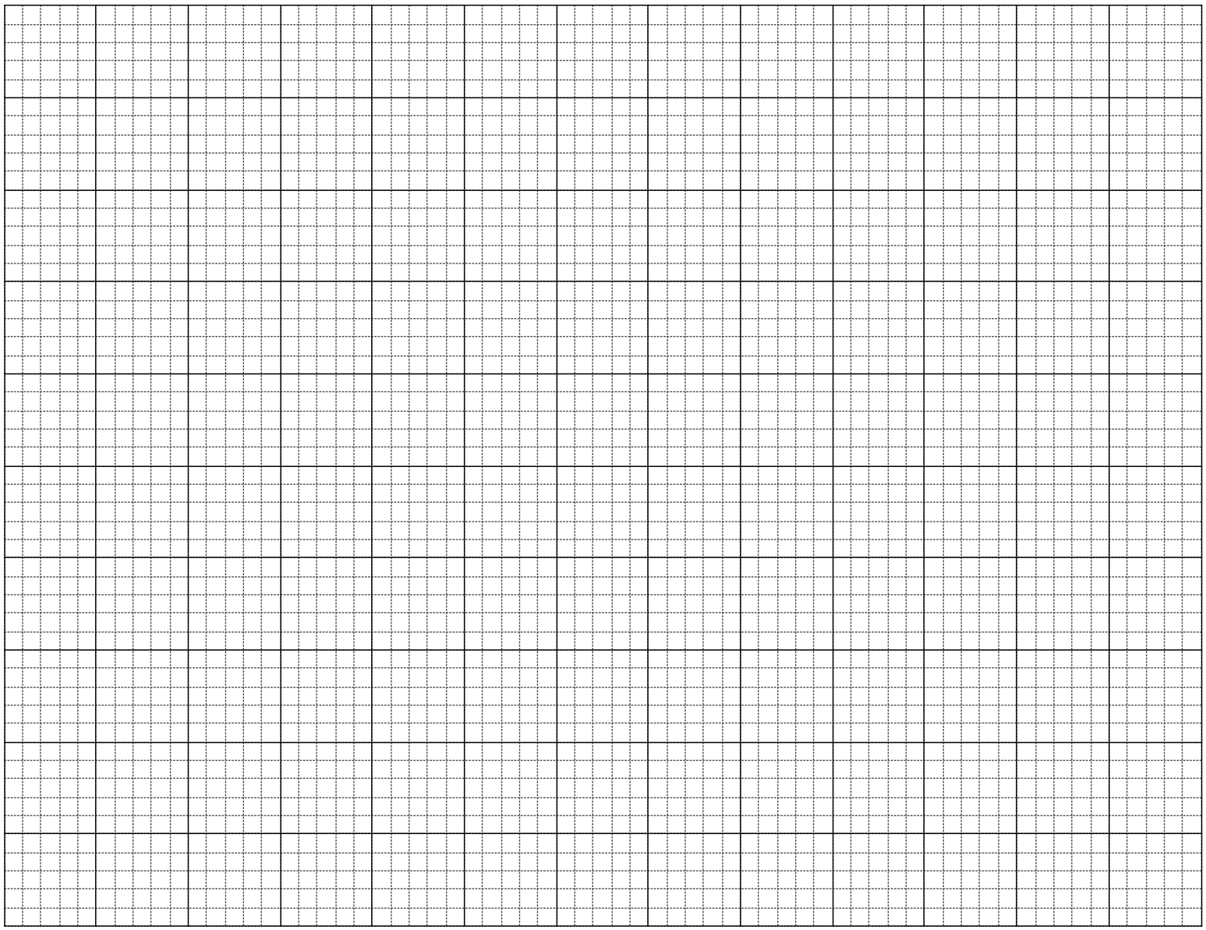
Calculator Free Q2
Question 2 (7 marks)
A group of 28 people gave a movie they had just watched together a rating of between one and five stars. Their star ratings are listed below:
(a) Explain why this type of data is considered categorical and choose one more word to further describe the data from the following list: nominal, ordinal, discrete, continuous. (2 marks)
(b) Complete the frequency table below for the ratings. (2 marks)
(c) Display the ratings as bar graph using the grid below. (3 marks)
2 | 4 | 4 | 2 | 2 | 1 | 4 | 4 | 4 | 2 | 4 | 3 | 3 | 1
5 | 2 | 4 | 5 | 2 | 4 | 4 | 2 | 2 | 3 | 2 | 5 | 4 | 3
Rating | Tally | Frequency
1
2
3
4
5

Slide 5
Calculator Free Q2
Question 2 (7 marks)
A group of 28 people gave a movie they had just watched together a rating of between one and five stars. Their star ratings are listed below:
(a) Explain why this type of data is considered categorical and choose one more word to further describe the data from the following list: nominal, ordinal, discrete, continuous. (2 marks)
(b) Complete the frequency table below for the ratings. (2 marks)
2 | 4 | 4 | 2 | 2 | 1 | 4 | 4 | 4 | 2 | 4 | 3 | 3 | 1
5 | 2 | 4 | 5 | 2 | 4 | 4 | 2 | 2 | 3 | 2 | 5 | 4 | 3
Solution
Categorical ordinal. A star rating is not a measurement but simply a way of categorising a person's opinion of a movie.
Specific behaviours
✓ explains categorical.
✓ chooses correct descriptor
Rating | Tally | Frequency
1 |  | 2
2 |  | 9
3 |  | 4
4 |  | 10
5 |  | 3
Solution
See table
Specific behaviours
✓ frequencies add to 28
✓ all frequencies correct

Slide 6
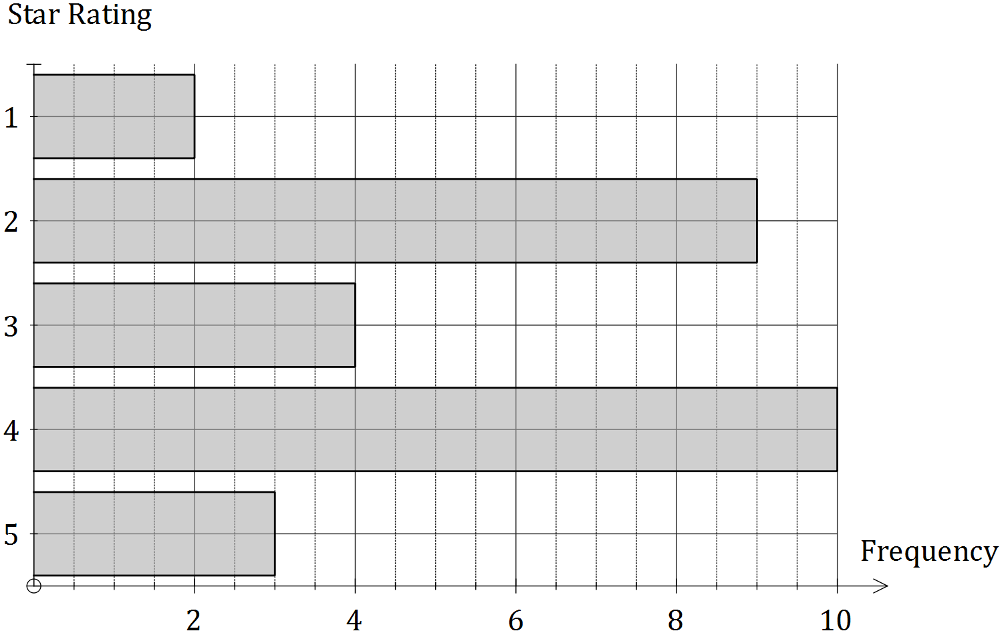
Calculator Free Q2
Question 2 (7 marks)
(b) Complete the frequency table below for the ratings. (2 marks)
(c) Display the ratings as bar graph using the grid below. (3 marks)
Rating | Tally | Frequency
1 |  | 2
2 |  | 9
3 |  | 4
4 |  | 10
5 |  | 3
Solution
See graph
Specific behaviours
✓ scale and 'f' on frequency axis, labels and description on category axis
✓ bars are equal width and parallel
✓ length of bars matches frequency table

Slide 7
Calculator Assumed Q1
Question 8 (6 marks)
A worker in a chemical factory earns $42.70 per hour on a weekday, time and a half at weekends, and a fixed allowance of $39.15 per day.
(a) Calculate the workers' weekly pay when she works from 9 am until 1 pm and then 1.30 pm until 4.30 pm from Wednesday to Sunday inclusive. (4 marks)
(b) Calculate the workers' total holiday pay when she takes four weeks leave, if the company pays her for 35 hours per week at her base rate, does not pay the fixed allowance but does add leave loading of 17.5%. (2 marks)

Slide 8
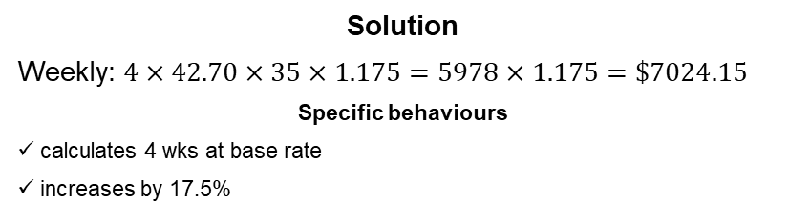
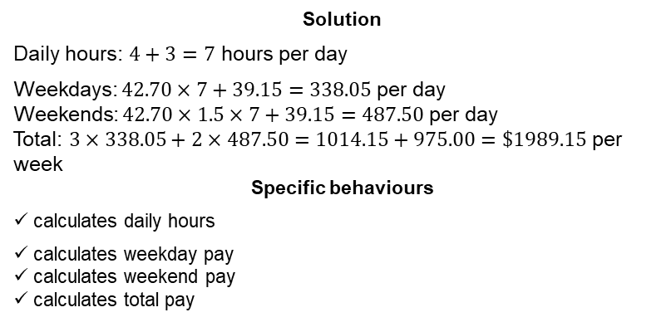
Calculator Assumed Q1
Question 8 (6 marks)
A worker in a chemical factory earns $42.70 per hour on a weekday, time and a half at weekends, and a fixed allowance of $39.15 per day.
(a) Calculate the workers' weekly pay when she works from 9 am until 1 pm and then 1.30 pm until 4.30 pm from Wednesday to Sunday inclusive. (4 marks)
(b) Calculate the workers' total holiday pay when she takes four weeks leave, if the company pays her for 35 hours per week at her base rate, does not pay the fixed allowance but does add leave loading of 17.5%. (2 marks)
Solution
Daily hours: $4+3=7$ hours per day
Weekdays: $42.70×7+39.15=338.05$ per day
Weekends: $42.70×1.5×7+39.15=487.50$ per day
Total: $3×338.05+2×487.50=1014.15+975.00=\$1989.15$ per week
Specific behaviours
✓ calculates daily hours
✓ calculates weekday pay
✓ calculates weekend pay
✓ calculates total pay
Solution
Weekly: $4×42.70×35×1.175=5978×1.175=\$7024.15$
Specific behaviours
✓ calculates 4 wks at base rate
✓ increases by 17.5%

Slide 9
Calculator Assumed Q2
Question 10 (6 marks)
A semi-circular grassed area has a radius of 45 m.
(a) A fence is to be installed around the edge of the area at a cost of $85 per metre. Calculate the cost of fencing to the nearest hundred dollars. (3 marks)
(b) A decorative building is to be built in the middle of the grassed area with a hemispherical glass roof. The cost of the building is $17 800 plus $235 per square metre for the glass used in the hemispherical roof. If the radius of the hemisphere is 4.5 m, calculate the total cost of the building to the nearest hundred dollars. (3 marks)

Slide 10


A semi-circular grassed area has a radius of 45 m.
(a) A fence is to be installed around the edge of the area at a cost of $85 per metre. Calculate the cost of fencing to the nearest hundred dollars. (3 marks)
(b) A decorative building is to be built in the middle of the grassed area with a hemispherical glass roof. The cost of the building is $17 800 plus $235 per square metre for the glass used in the hemispherical roof. If the radius of the hemisphere is 4.5 m, calculate the total cost of the building to the nearest hundred dollars. (3 marks)
Solution
Curved length: $2×π×45÷2=141.4$ m
Total: $2×45+141.4=231.4$ m
Cost: $231.4×85=19669≈\$19 700$
Specific behaviours
✓ calculates curved side
✓ calculates total length
✓ calculates cost, rounding to nearest $100
Solution
Area of glass: $4×π×{4.5}^{2}÷2=127.2$ m²
Cost: $17800+127.2×235=17800+29892=47692≈\$47 700$
Specific behaviours
✓ uses sphere area formula
✓ adjusts for hemisphere
✓ calculates total cost, rounding to nearest $100

